Slide 1
Discrete Mathematics
What are propositional equivalences?
Propositions – Lesson 4
October 7th, 2013

Slide 2
Tautology?
A compound proposition that is always true, no matter what the truth values of the propositional variables that occur in it, is called a tautology.
Ex-p ∨ ￢p is always true, it is a tautology.

Slide 3
Contradiction?
A compound proposition that is always false is called a contradiction.
Ex- p ∧￢p is always false, it is a contradiction.
P=I am a student.

Slide 4
Logical Equivalences
Compound propositions that have the same truth values in all possible cases are called logically equivalent. We can also define this notion as follows.
The compound propositions p and q are called logically equivalent if p ↔ q is a tautology.
The notation p ≡ q denotes that p and q are logically equivalent.
Remark: The symbol ≡ is not a logical connective, and p ≡ q is not a compound proposition but rather is the statement that p ↔ q is a tautology. The symbol ⇔ is sometimes used instead of ≡ to denote logical equivalence.

Slide 5
De Morgan laws
This logical equivalence is one of the two De Morgan laws, named after the English mathematician Augustus De Morgan, of the mid-nineteenth century.
￢(p ∧ q) ≡ ￢p ∨￢q
￢(p ∨ q) ≡ ￢p ∧￢q
Show that ￢(p ∨ q) and ￢p ∧￢q are logically equivalent using a truth table.

Slide 6
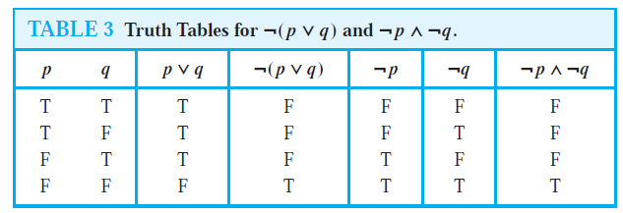
Compare it with your answer
The same truth values in all possible cases

Slide 7
Show that p → q and ￢p ∨ q are logically equivalent using truth table.

Slide 8
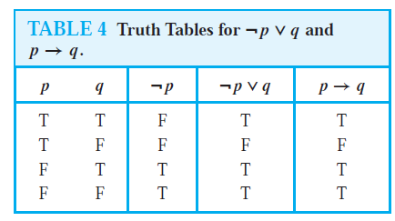
Compare it with your answer

Slide 9
If more than 2 variables…..
In general, 2^{n}rows are required if a compound proposition involves n propositional variables.
Ex- variables p, q, and r. To use a truth table to establish such a logical equivalence, we need eight rows.

Slide 10
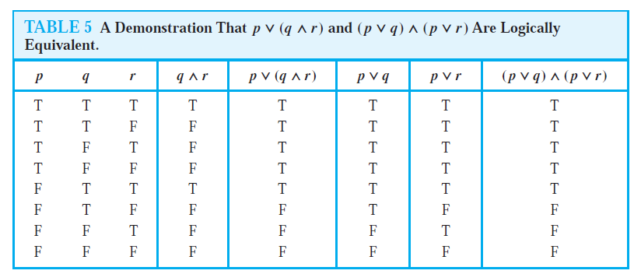
Show that p ∨ (q ∧ r) and (p ∨ q) ∧ (p ∨ r) are logically equivalent. This is the distributive law of disjunction over conjunction.

Slide 11
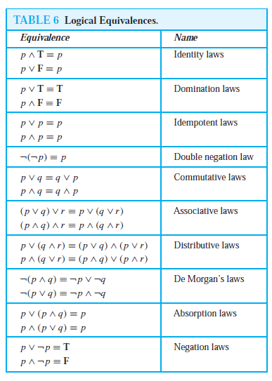
Table 6 contains some important equivalences. In these equivalences, T denotes the compound proposition that is always true and F denotes the compound proposition that is always false.

Slide 12
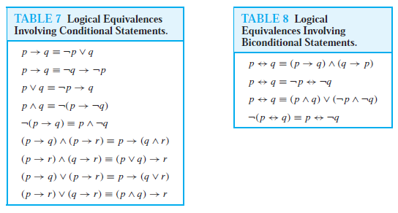
Some more equivalences:

Slide 13
Show that ￢(p → q) and p ∧￢q are logically equivalent.
￢(p → q) ≡ ￢(￢p ∨ q) by Example 3
≡ ￢(￢p)∧￢q by the second De Morgan law
≡ p ∧￢q by the double negation law

Slide 14
Show that ￢(p ∨ (￢p ∧ q)) and ￢p ∧￢q are logically equivalent by developing a series of logical equivalences.
￢(p ∨ (￢p ∧ q)) ≡ ￢p ∧￢(￢p ∧ q) by the second De Morgan law
≡ ￢p ∧ [￢(￢p)∨￢q] by the first De Morgan law
≡ ￢p ∧ (p ∨￢q) by the double negation law
≡ (￢p ∧ p) ∨ (￢p ∧￢q) by the second distributive law
≡ F ∨ (￢p ∧￢q) because ￢p ∧ p ≡ F
≡ (￢p ∧￢q) ∨ F by the commutative law for disjunction
≡ ￢p ∧￢q by the identity law for F

Slide 15
Show that (p ∧ q) → (p ∨ q) is a tautology.
(p ∧ q) → (p ∨ q) ≡ ￢(p ∧ q) ∨ (p ∨ q) by Example 3
≡ (￢p ∨￢q) ∨ (p ∨ q) by the first De Morgan law
≡ (￢p ∨ p) ∨ (￢q ∨ q) by the associative and commutative
laws for disjunction
≡ T ∨ T by Example 1 and the commutative
law for disjunction
≡ T by the domination law

Slide 16
Homework
9. Show that each of these conditional statements is a tautology without using truth tables.
a) (p ∧ q) → p
b) p → (p ∨ q)
c) ￢p → (p → q) d) (p ∧ q) → (p → q)
e) ￢(p → q) → p f ) ￢(p → q)→￢q
10. Show that each of these conditional statements is a tautology without using truth tables.
a) [￢p ∧ (p ∨ q)] → q
b) [(p → q) ∧ (q → r)] → (p → r)
c) [p ∧ (p → q)] → q
d) [(p ∨ q) ∧ (p → r) ∧ (q → r)] → r

